Slide 1
Database Management Systems
Tuğba Önal-Süzek
email: tsuzek@gmail.com

Slide 2
Outline
General Course Information
Do we need databases? What do we need databases for?
What’s a Data Model?
Structure of Relational Databases

Slide 3
ANNOUNCEMENT
1)Please enroll to the whatsapp group to receive announcements…
2)Lecture notes and the text-book are available at DYS

Slide 4
CENG 3005
Instructor: Tuğba Önal-Süzek
Teaching Assistant: Erdem Turk
Office: E1-10
Email: tsuzek@gmail.com
Lecture Hours: Mon 9:30-11:10 (Education Faculty 304)
Lab Hours : Mon 11:30-12:20 (B3B08)
Fri 13:30-14:10 (B3B08)

Slide 5
Textbooks and References
A. Silberschatz, H.F. Korth, S. Sudarshan, Database System Concepts, McGraw Hill, 4th edition, 2002.
Online at:
http://eng1.mu.edu.tr/~tugba/DB/ceng2008_book.pdf

Slide 6
Grading
Midterm (written exam) 40%
Bitbucket commits and Class Attendance 10%
Attendance is mandatory.
If you miss 4 weeks plus 1 lecture, your grade is TT
Even if you got FF last year, you need to attend
Final project/Final exam 50%
Project specification (due December)
Project Final Demo (Code/Report/SQL quiz)

Slide 7
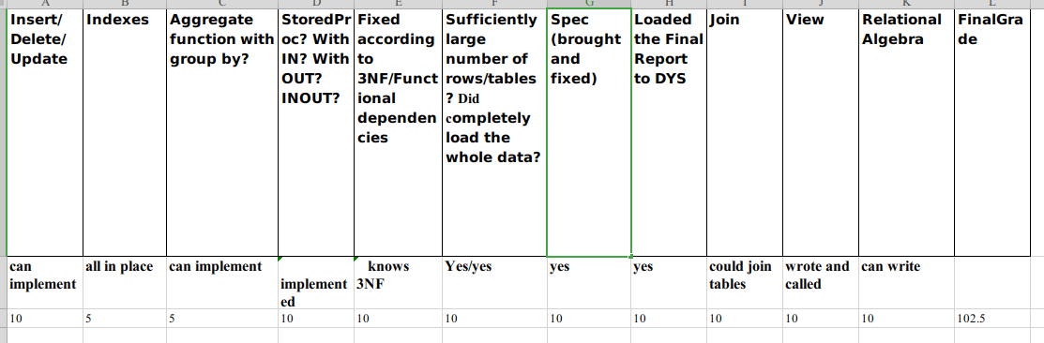
Policies
Academic honesty is required in all work
All your work must either belong to you or properly cite where you got it from.
Exam is a written exam with cheat-sheet
Final is a one-to-one interview with cheat-sheet

Slide 8
Tentative Syllabus
Introduction to Database Management Systems (I)
Relational Algebra
B+ trees and File Structures
SQL
Advanced SQL
Entity-Relationship(ER) Model
Relational Database Design
XML
Revision of Database design and Normalization factors
Midterm
Query Processing , Optimization
Transactions and Concurrency control
Final: Demo of your DB system and Oral Quiz

Slide 9
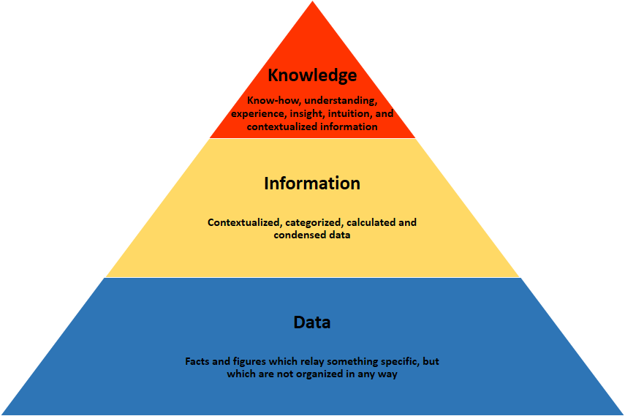
What is Data ? What is Information?

Slide 10
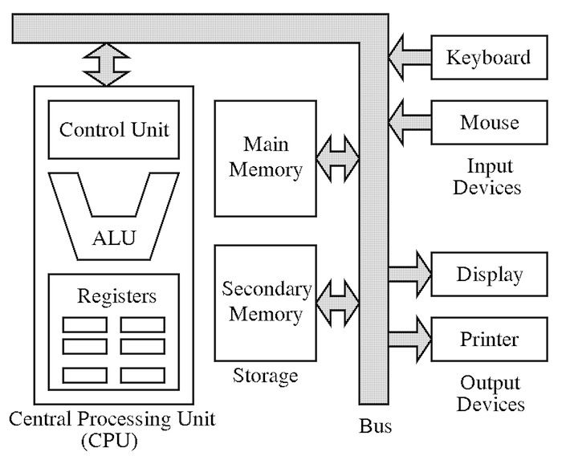
Remember the Von Neumann Architecture
Where do we store the
Data?

Slide 11
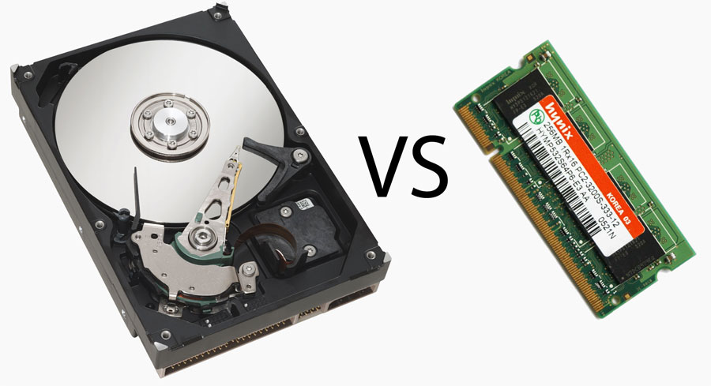
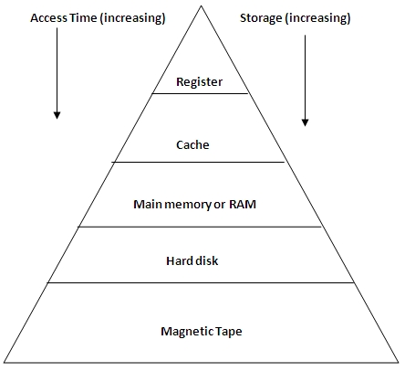
Where do we store the Data?
Hard disk: slow!
RAM: fast!

Slide 12
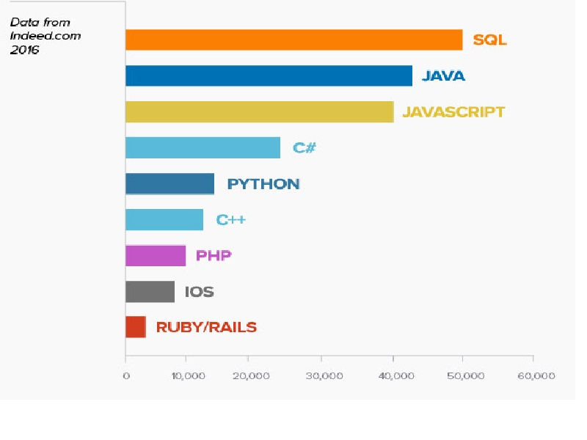
Languages ranked by number of job ads

Slide 13
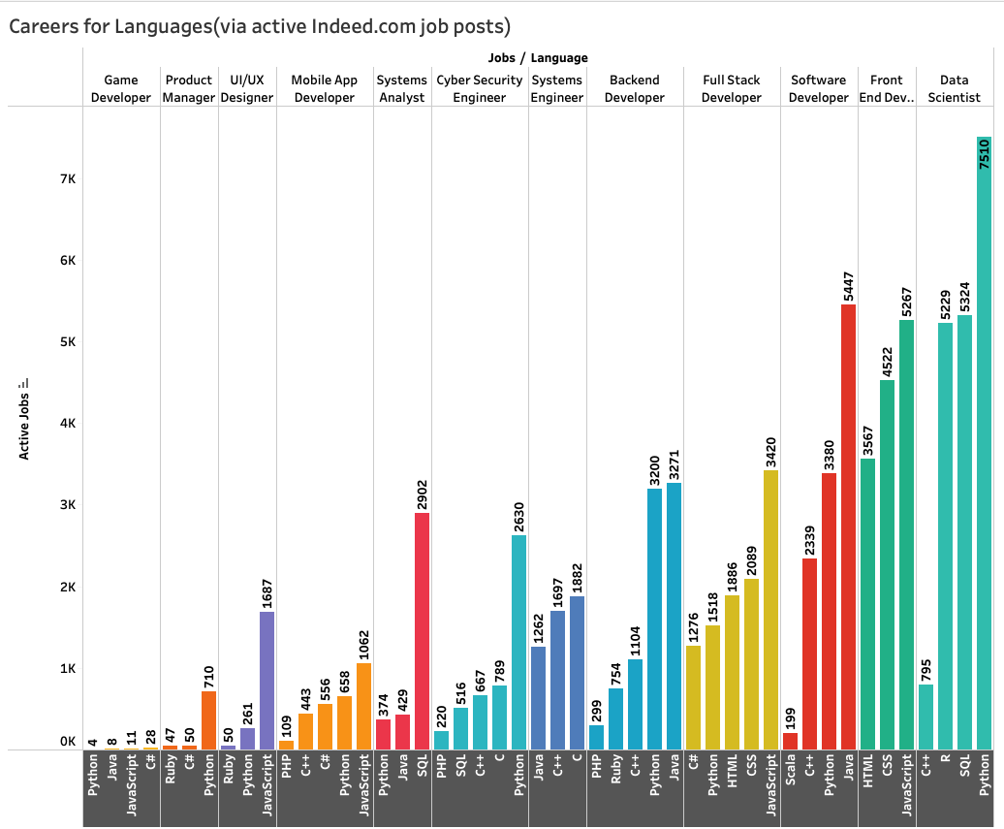

Slide 14
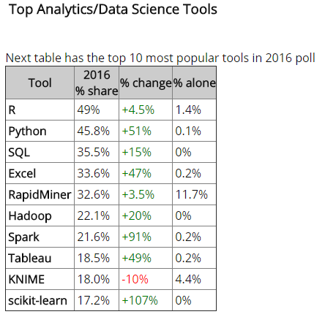
Importance of SQL for Data Science
These 3 programming languages:
R
Python
SQL
Together form the top 3 most used programming languages in data science https://www.reddit.com/r/dataisbeautiful/comments/v3h2g7/programming_languages_for_tech_careers_based_on/#lightbox

Slide 15
What is a Database?
a collection of data
made up of “tables”
tables store “similar” information

Slide 16
What Is a Database Management System (DBMS)?
Database is a very large and integrated collection of data.
Entities (e.g., students, courses) (e.g. ligands,proteins)
Relationships
(e.g., Ali is taking CENG2008)
(e.g. bisphenolA decreases expression of SHANK3)

Slide 17
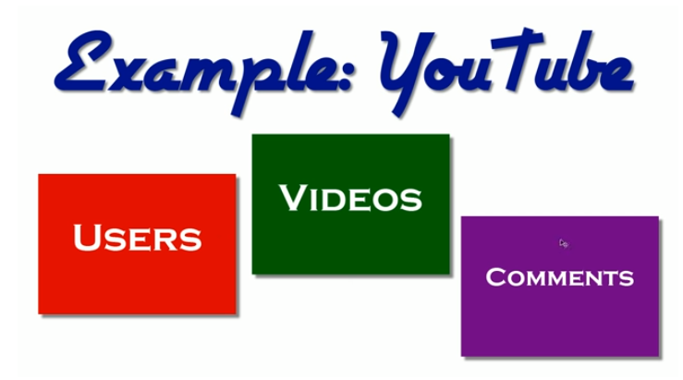

Slide 18
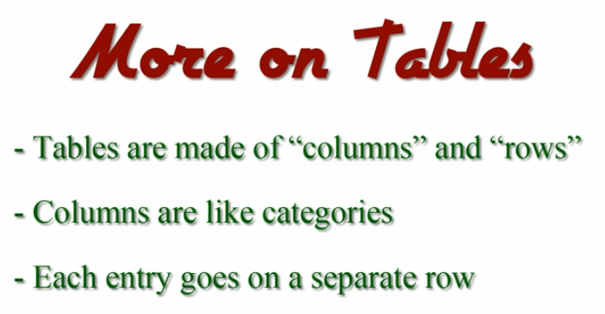

Slide 19
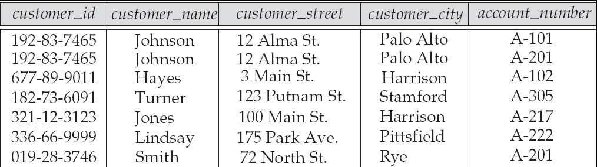
Table
Example of tabular data in the relational model
Attributes

Slide 20
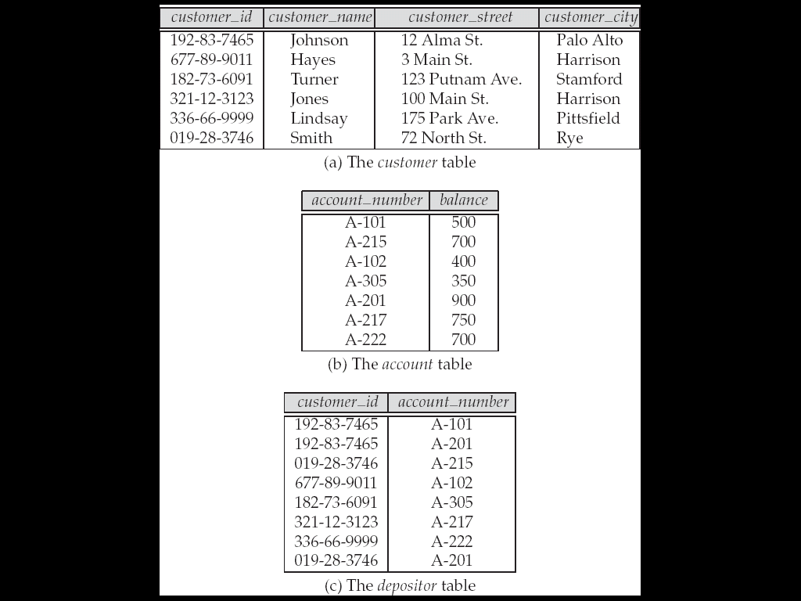
A Sample Database

Slide 21
SQL: Structured Query Language
SQL: widely used non-procedural language
Example: Find the name of the customer with customer-id 192-83-7465 select customer.customer_name from customer where customer.customer_id = ‘192-83-7465’
Example: Find the balances of all accounts held by the customer with customer-id 192-83-7465 select account.balance from depositor, account where depositor.customer_id = ‘192-83-7465’ and depositor.account_number = account.account_number
Application programs generally access databases through one of
Language extensions to allow embedded SQL
Application program interface (e.g., ODBC/JDBC) which allow SQL queries to be sent to a database

Slide 22
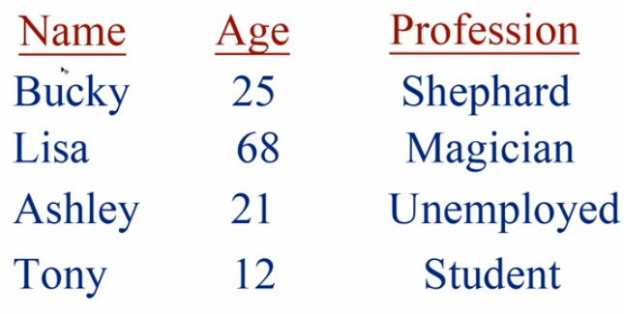

Slide 23
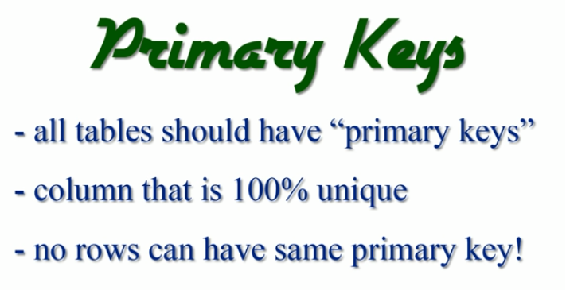

Slide 24
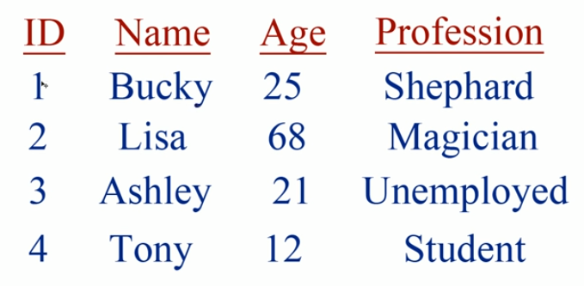

Slide 25
Why Study Databases??
?
Shift from computation to information
at the “low end”: scramble to webspace (a mess!)
at the “high end”: scientific applications
Datasets increasing in diversity and volume.
Digital libraries, interactive video, Human Genome project
The need for DBMS is exploding!
DBMS encompasses most of CS
OS, languages, theory, “AI”, multimedia, logic

Slide 26
Structure of a DBMS
These layers
must consider
concurrency
control and
recovery
A typical DBMS has a layered architecture.
This is one of several possible architectures; each system has its own variations.
Query Optimization
and Execution
Relational Operators
Files and Access Methods
Buffer Management
Disk Space Management
DB
Notes:
22

Slide 27
Why Use a DBMS?
Data independence and efficient access.
Reduced application development time.
Data integrity and security.
Uniform data administration.
Concurrent access, recovery from crashes.
What if all our data can fit into RAM (memory)?
Do we still need databases?
Notes:
3

Slide 28
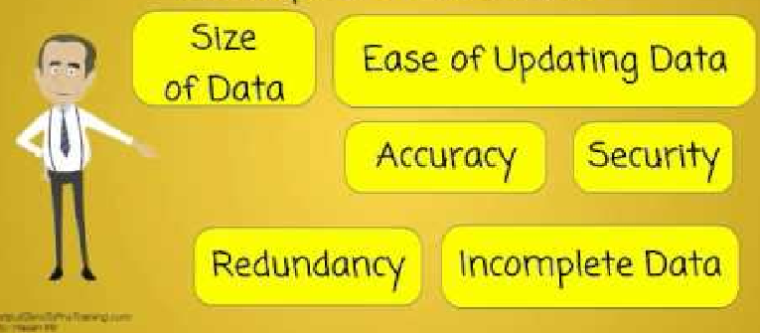
So, why again?

Slide 29
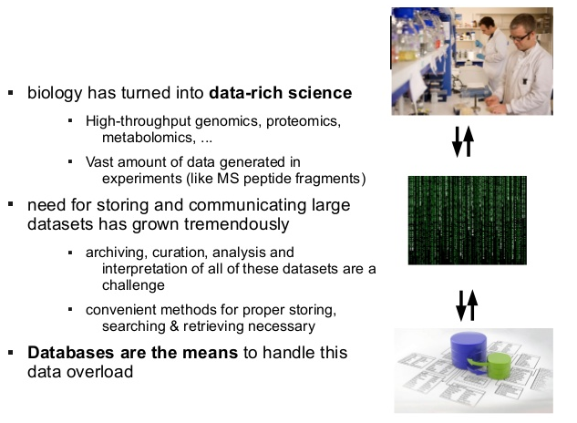
Why do we need databases for Biology?

Slide 30
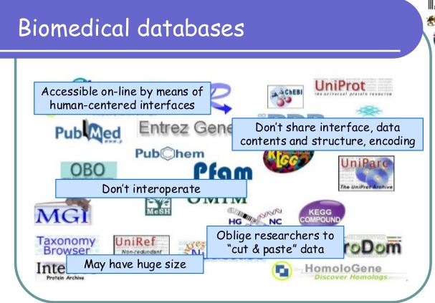

Slide 31
6 steps to mastering SQL for Data Science
Learn Relational Database Basics
Theoretical foundation is Relational Algebra
Practical foundation is the File Structures
Learn SQL basics
Learn Selecting/Inserting/Updating
Learn Creating/Dropping/Deleting
Create and Drop tables
Delete records
Using Views and Joins
Final goal: SQL integration with R or Python or Java
SQL is usually embedded in other software written in other programming languages as part of a larger system.
Some other language making calls to a database via SQL to input, modify, or retrieve application-related data.

Slide 32
HOMEWORK
Find two project partners
Find some data with at least 30 columns and 500 rows
->multiplication of which should be greater than 15000

